Slide 1
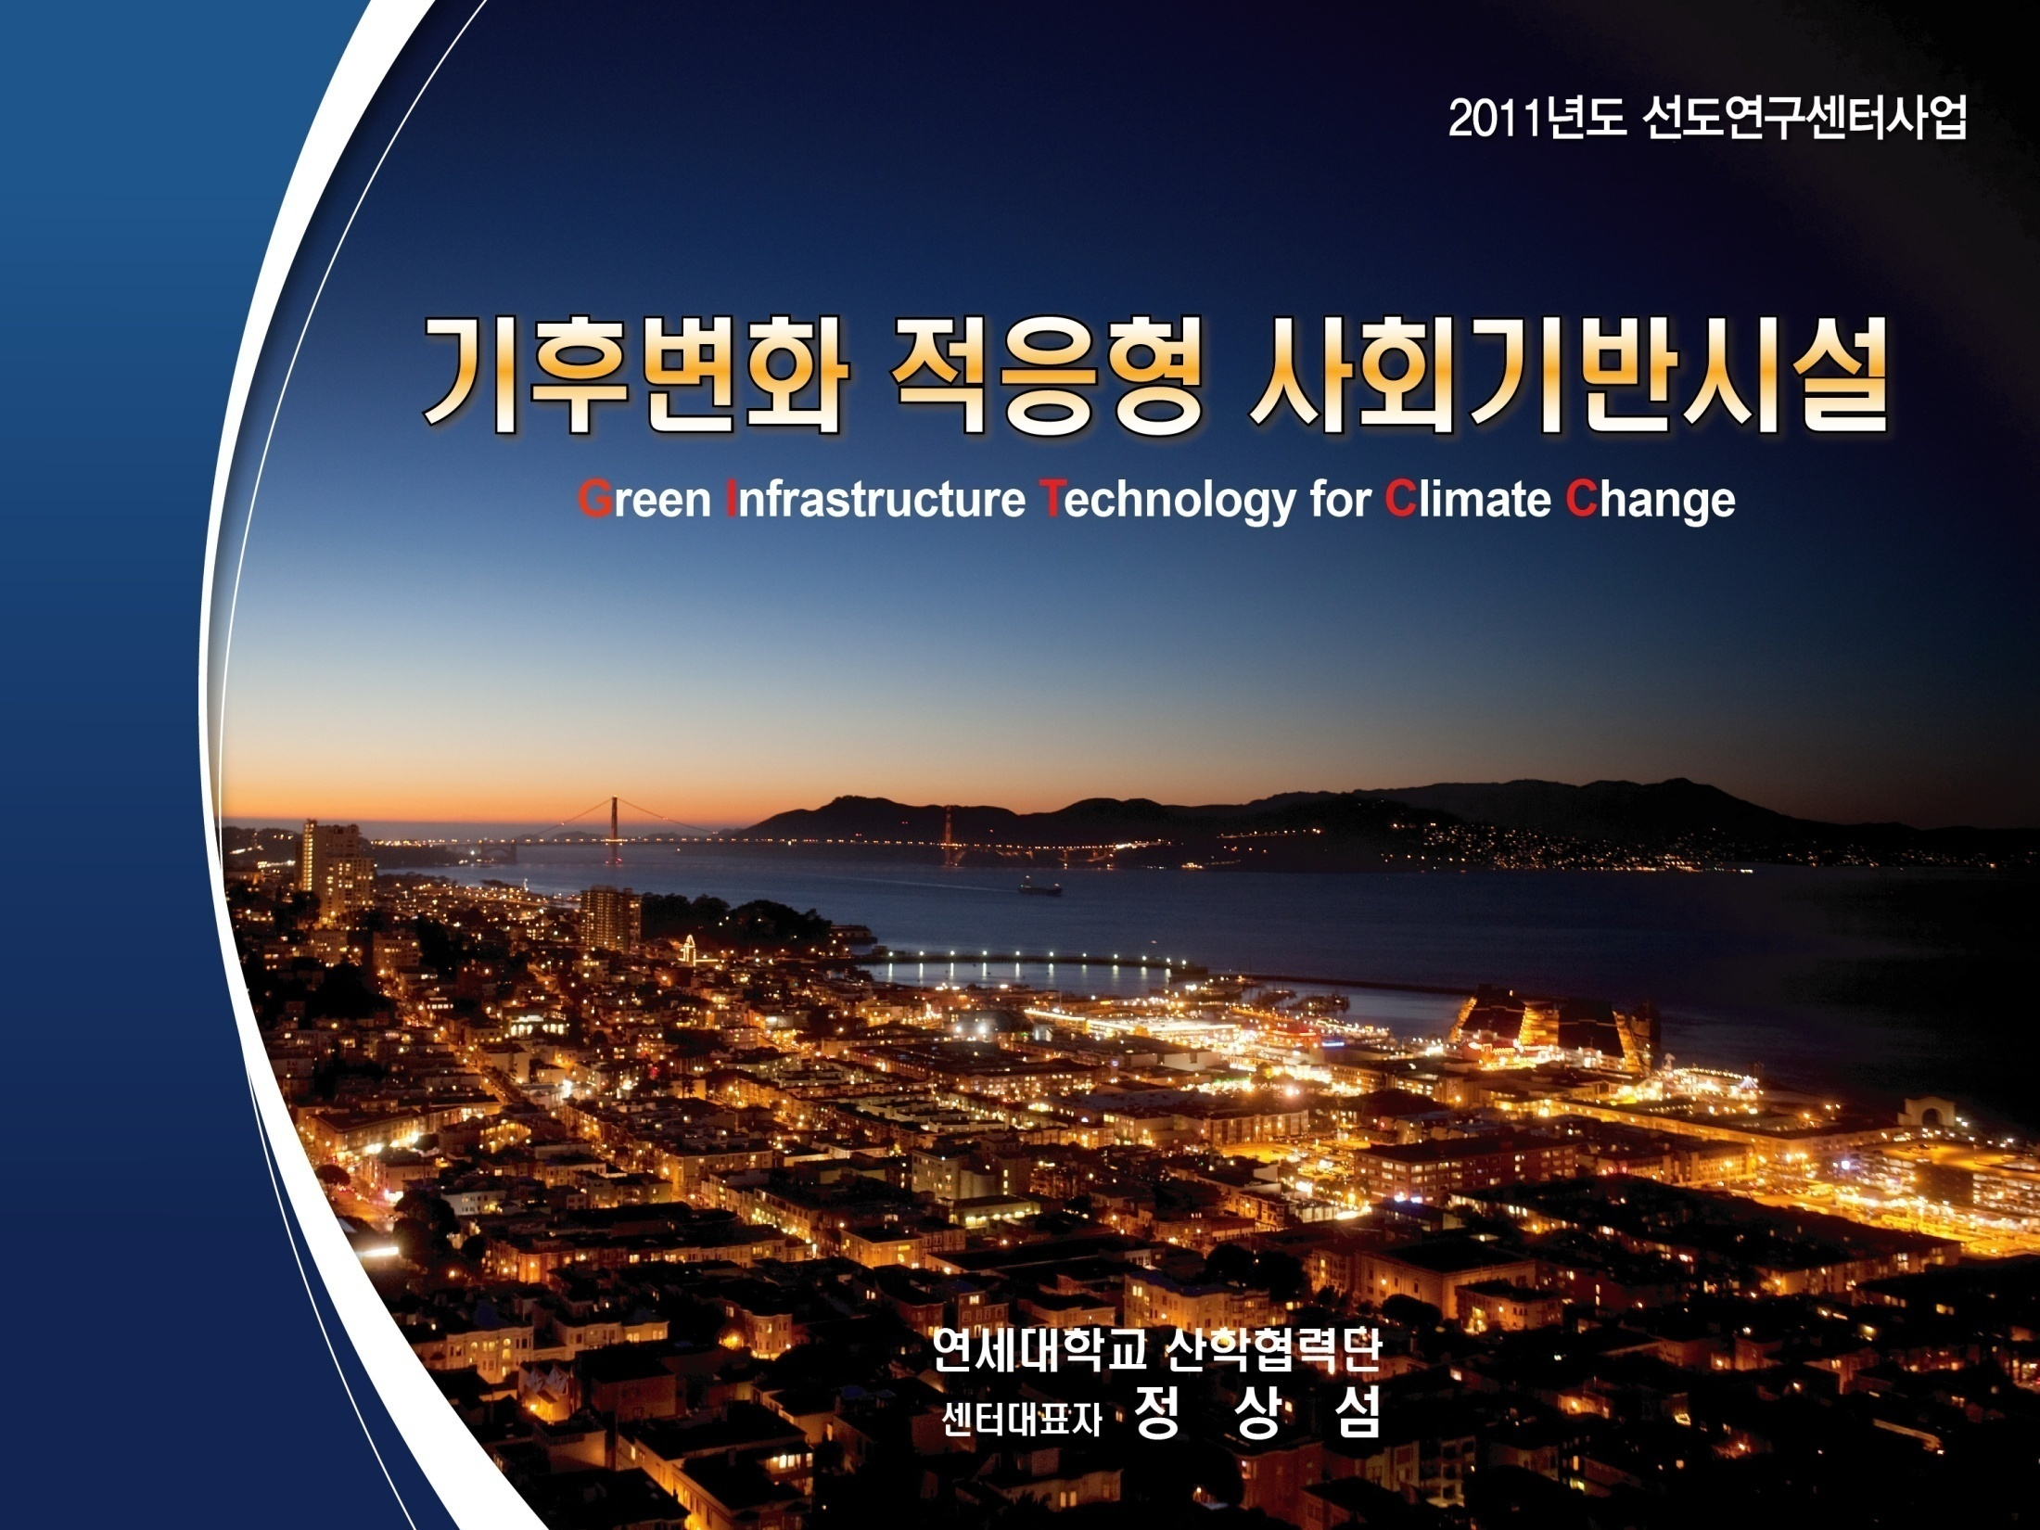

Introduction of GIT4CC
GEOSS/AWCI
(Green Infrastructure Technology for Climate Change)
Hyoungkwan Kim
GIT4CC Secretary
Associate Professor
Yonsei University
2011-10-07

Slide 2
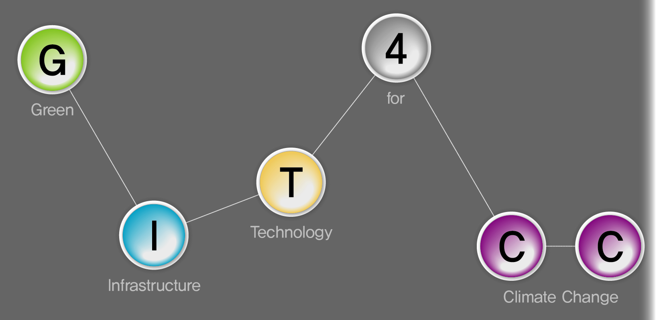
GIT4CC
The Green Infrastructure Technology for Climate Change (GIT4CC) center aims to develop civil infrastructure adaptation technologies based on mid- and long-term predictions of climate changes.

Slide 3
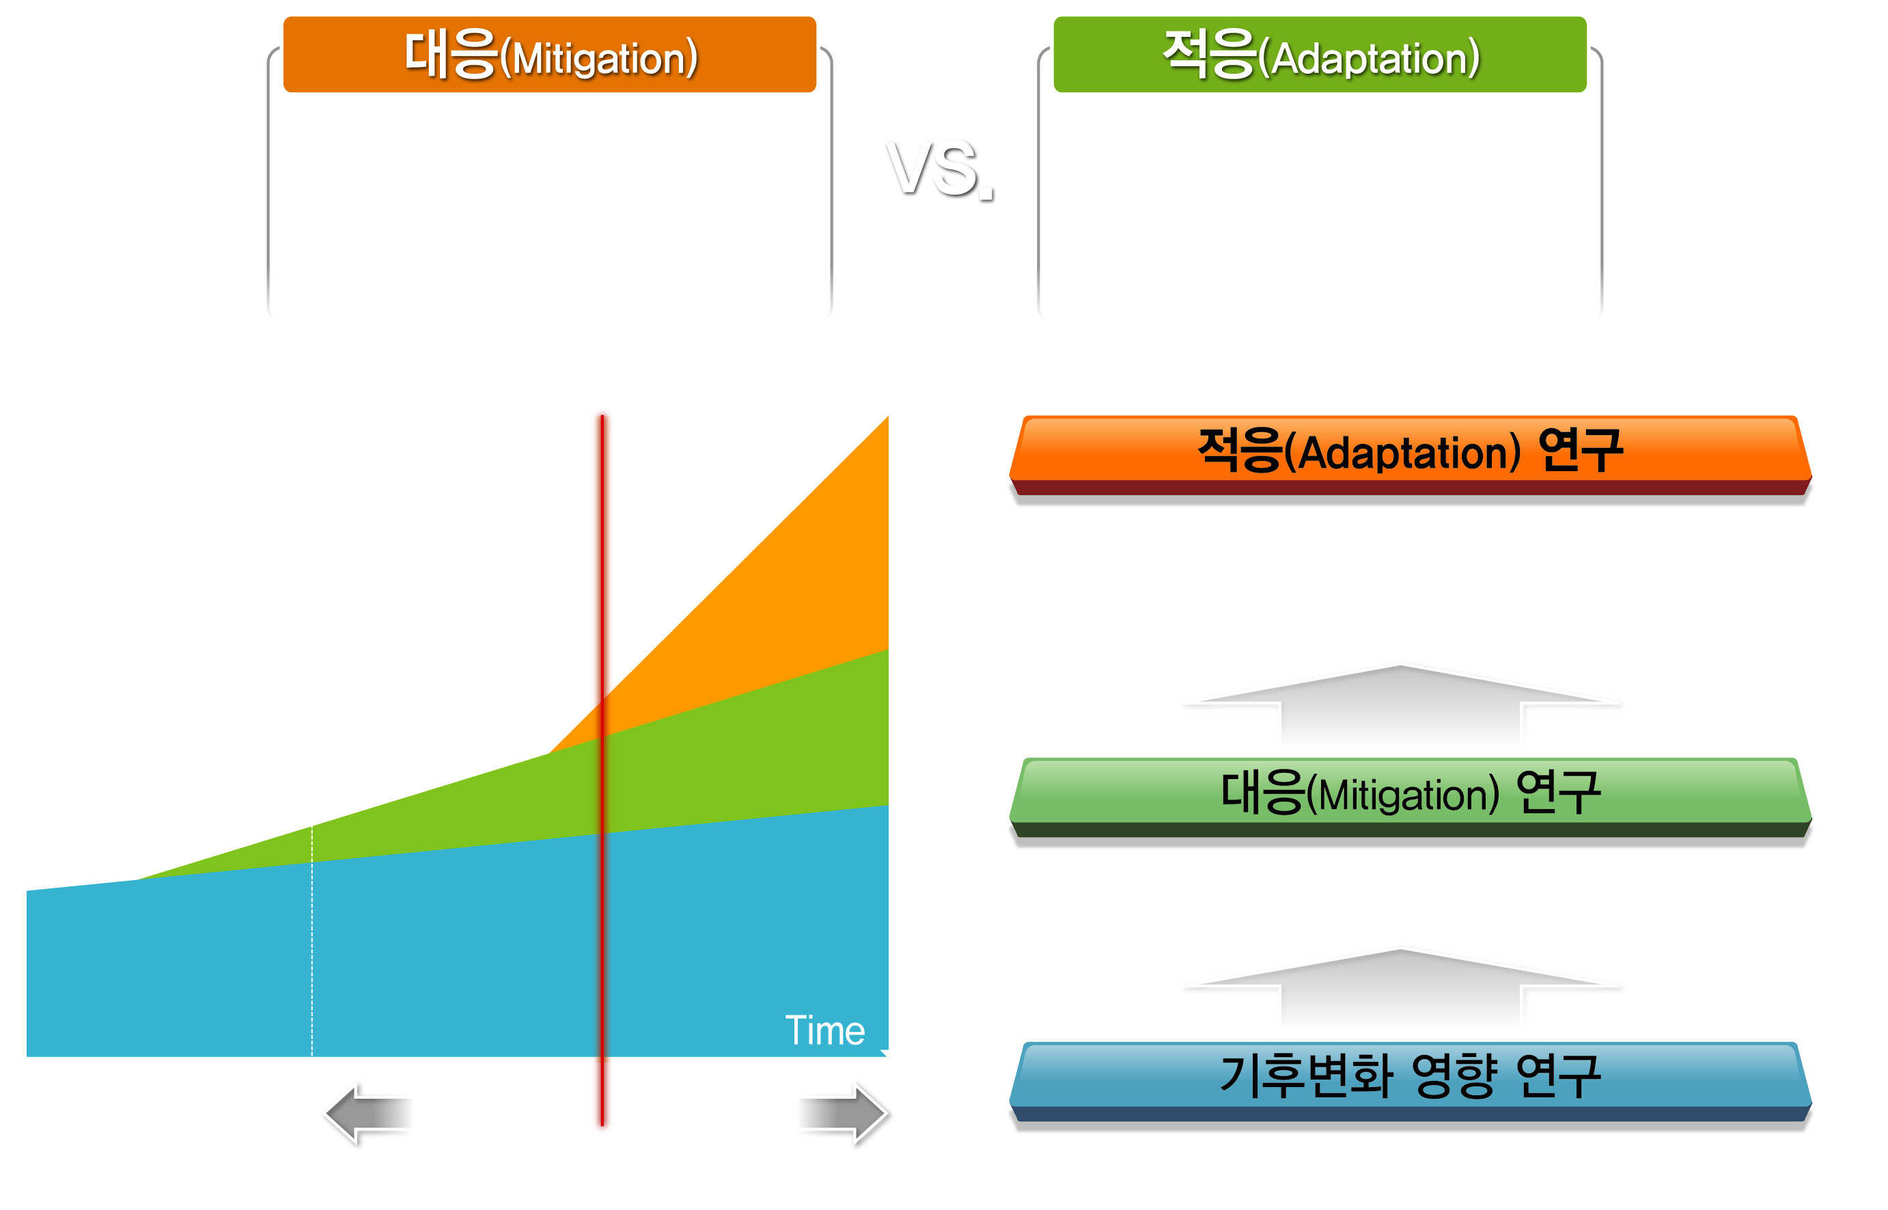
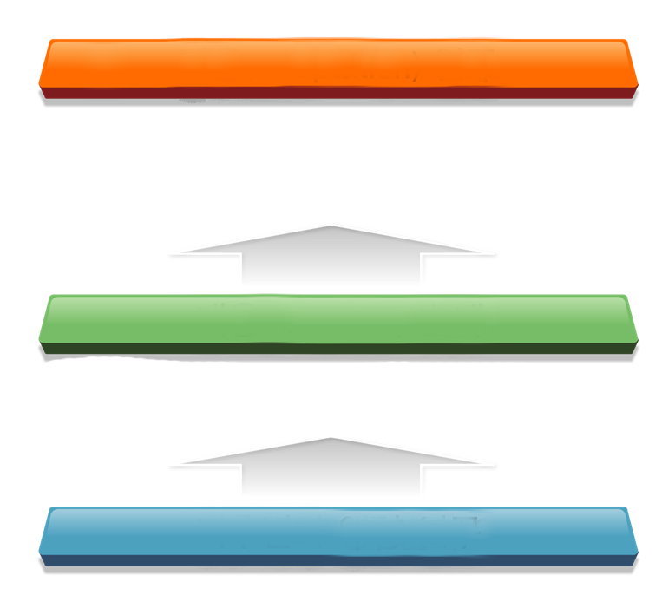
Research Trends
Adaptation Research
Considering climate change as reality, adaptation technologies are pursued
Mitigation Research
CO2 reduction, etc.
Climate System Research
(PEER, 2009)
Climate change estimation, etc.

Slide 4


Research Objectives
Adaptation technology development for civil infrastructure
Area 1
Area 2
Area 3
Proactive optimization of adaptation technologies
Civil infrastructure adaptation technologies
Regenerative water resource and environmental technology
Climate and hydrological scenario creation
Optimization of proactive adaptation strategies
Adaptive geotechnical design
Multi-climate concrete
Porous pavement technology for improved water cycling
Urban hydro-ecology improvement
Coastal management technologies for sea level rise

Slide 5
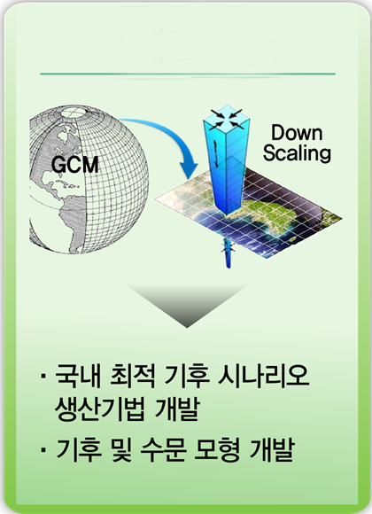
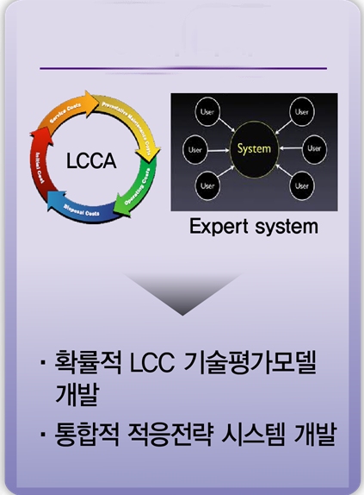
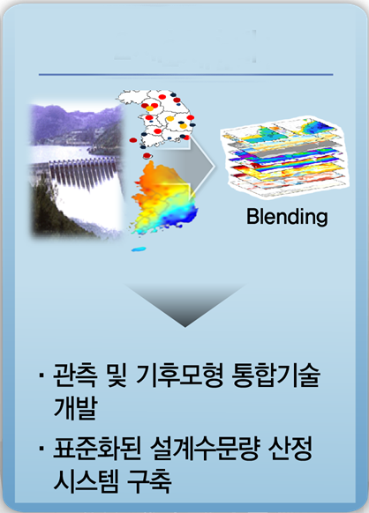


Area I
Climate scenario for Korea
Hydrological model for infra design
Probabilistic LCC evaluation
Adaptation strategies
Integration of climate model and measured data
Standardized design parameters
Infrastructure Adaptation Framework

Slide 6
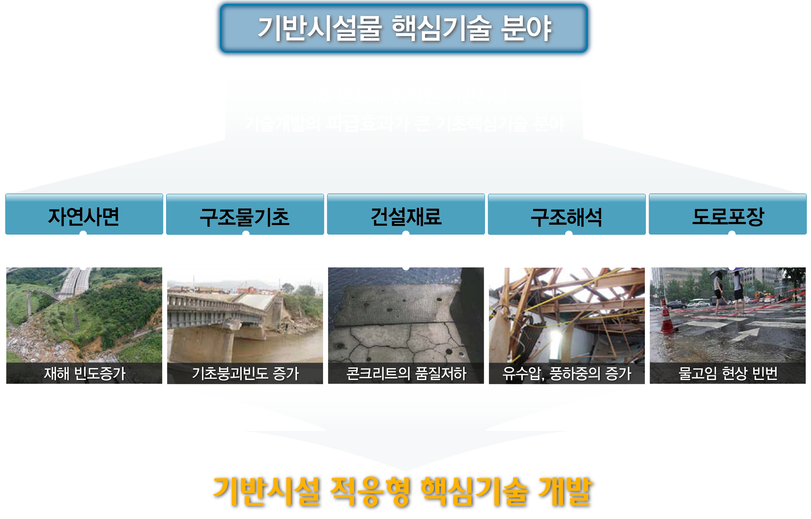
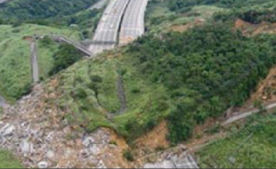
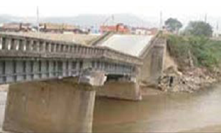
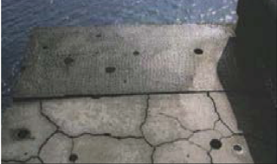
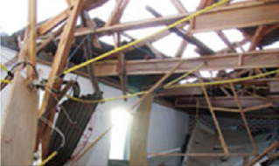
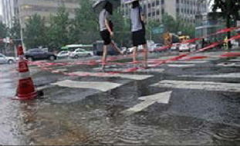
Area II
Adaptation technologies
for the weakest fields of infrastructure
in climate change
Disaster prediction for natural slopes
Adaptive geotechnical design
Concrete for extreme weather
Slimming technology
Porous pavement technology
Core Adaptation Technologies

Slide 7
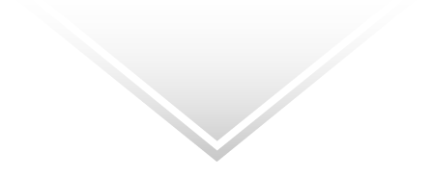
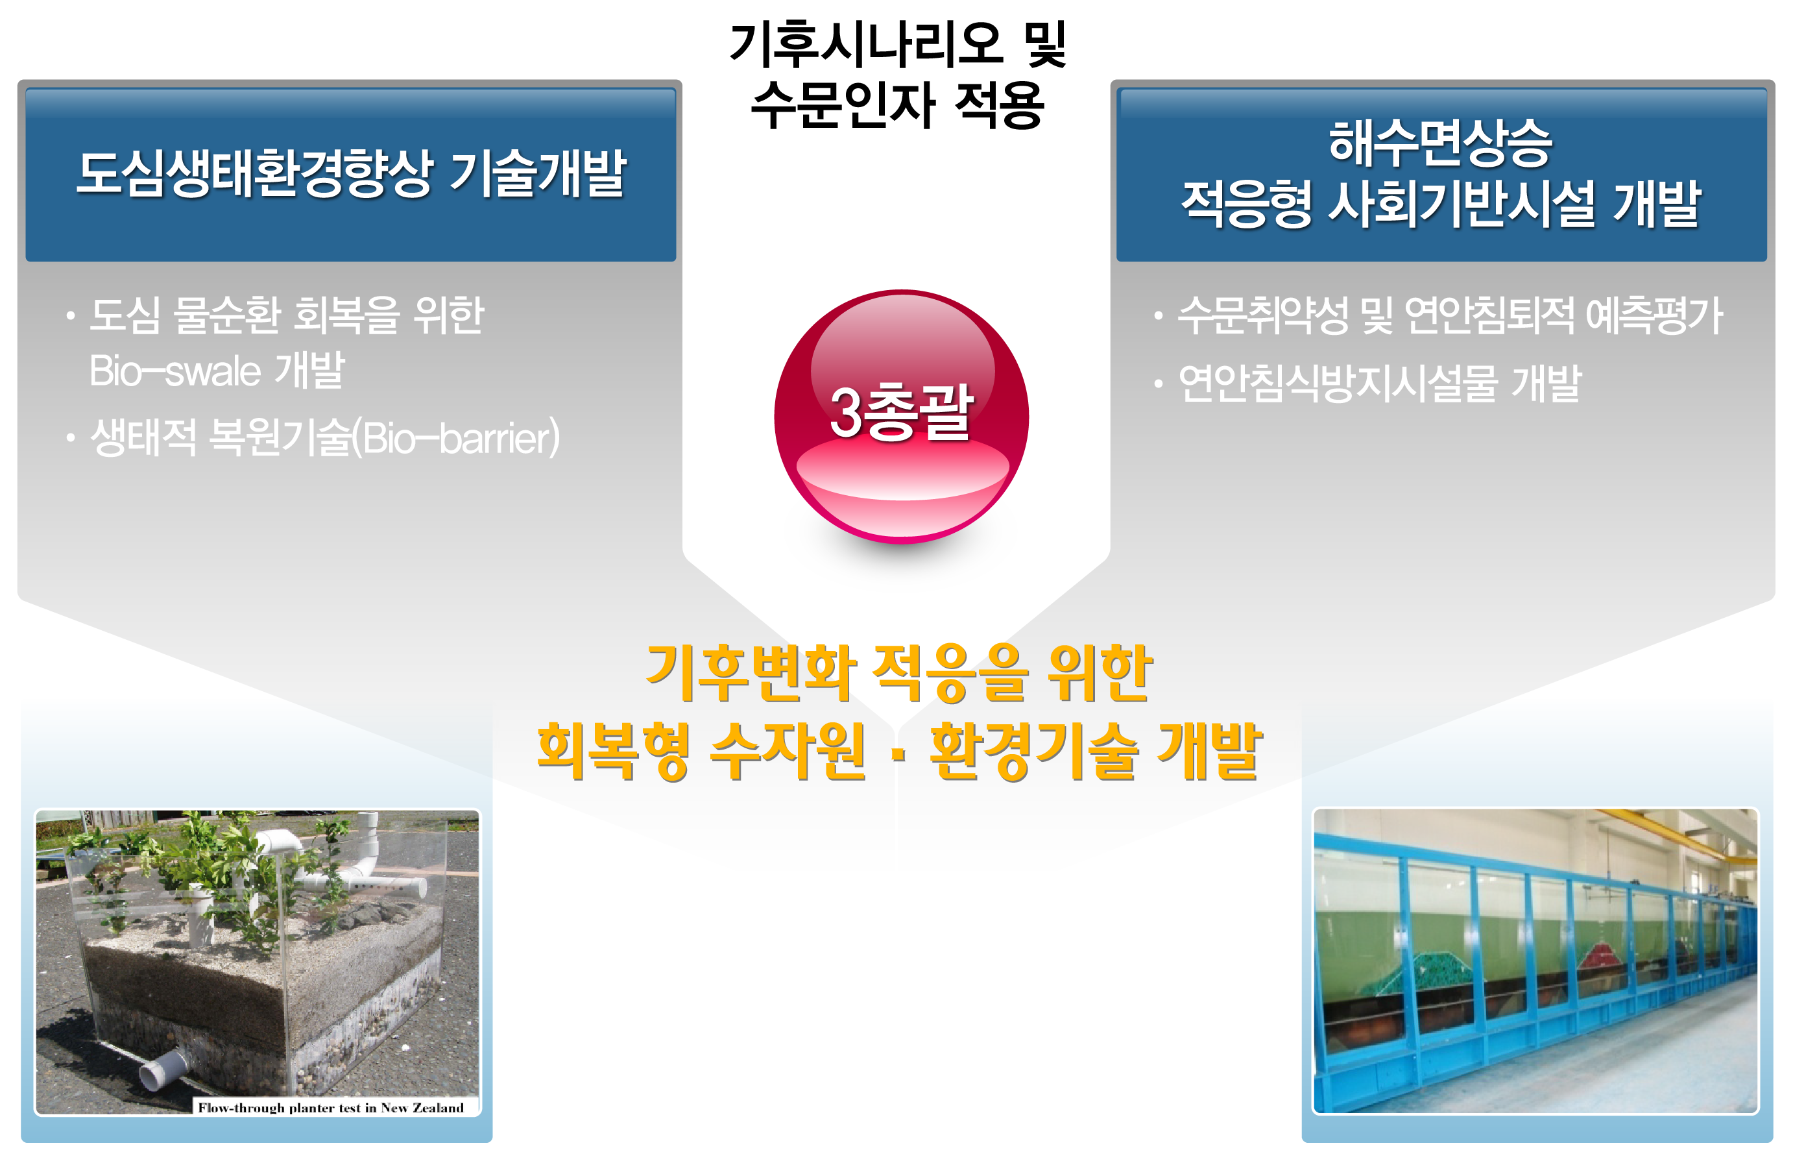
Area III
Urban hydro-ecology improvement
Costal management for sea level rise
Bio-swale
Bio-barrier
Costal erosion prediction
Submerged structure for prevention of the erosion
Regenerative water resource
and environmental technologies

Slide 8

Interrelationships among the Areas
Engineering parameters
Area II
1: Slope management
Area I
Area III
2: Adaptive geotech
1: Climate/hydro scenarios
1: Unban ecology improment
3: Multi-climate concrete
2: Hydro-parameters
2: Costal management
4: Slimming technology
3: Proactive strategy
5: Porous pavement
Socio-economic evaluation of technolgies
Adaptation technologies
Regenerative technologies

Slide 9
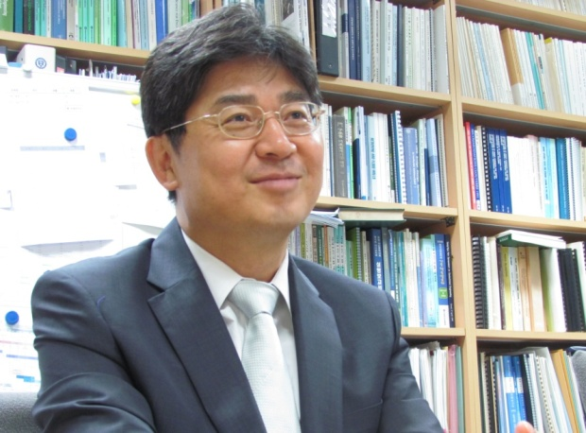


Director
Name
Jeong, Sangseom
Education
1979. 03 ~ 1983. 02 Yonsei University, BS
1986. 09 ~ 1988. 12 University of California, Davis.
MS
1989. 01 ~ 1992. 08 Texas A&M Univ, PhD
Research interest
Foundations for high-rise structures
Slope stability
Earthquake-resistant independent footing
Tunnel analyses
Large-scale pile design under lateral load

Slide 10
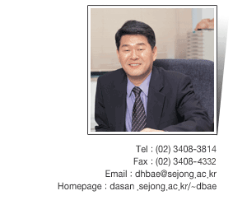
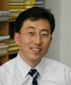
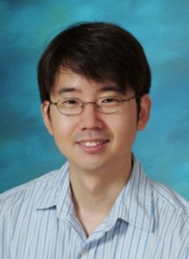
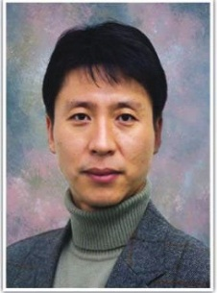
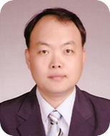
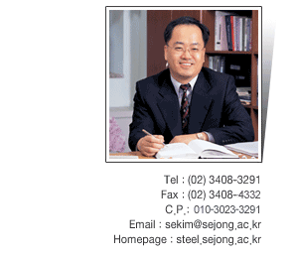
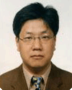
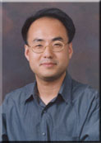

Researchers
Area I
Bae, duckhyo
(Sejong Univ.)
Kim, Kwangseop
(Kyungbook Univ.)
Kim, Hyoungkwan
(Yonsei Univ.)
Area II
Lee, Junwhan
(Yonsei Univ.)
Kim, Jay Jangho
(Yonsei Univ.)
Kim, Seunguk
(Sejong Univ.)
Moon, Seongho
(Seoul Science and Tech. Univ.)
Area III
Kang, Hojeong
(Yonsei Univ.)
Lee, Jongin
(Joennam Univ.)

Slide 11
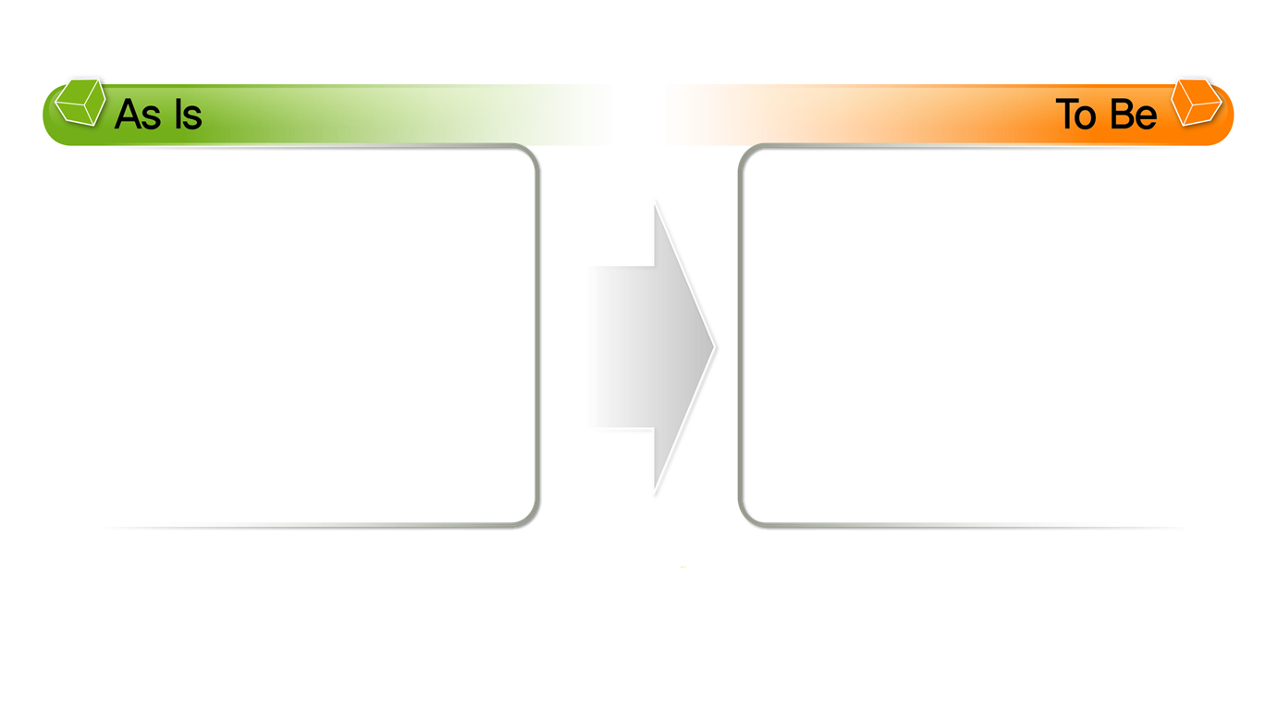
Research Contributions
Infrastructure Adaptation for Climate Change
General climate change scenarios
Reactive approach
Scattered strategies
Climate change scenarios for infrastructure
Proactive approach
Integrated strategies
11

Slide 12
Thank you

